Slide 1


Iyas Adel Abdulrahman
7st December 2022

Slide 2
Outline
Executive Summary
Introduction
Methodology
Results
Conclusion
Appendix

Slide 3

Executive Summary
In this capstone, we will predict if the Falcon 9 first stage will land successfully. SpaceX advertises Falcon 9 rocket launches on its website, with a cost of 62 million dollars; other providers cost upward of 165 million dollars each, much of the savings is because SpaceX can reuse the first stage. Therefore, if we can determine if the first stage will land, we can determine the competitive cost of a launch; being able to predict successful landing of 1st stage results into achieving competitive edge advantage of SpaceX over its’ competitors
The project composed of the following four phases:
Data collection & Cleaning.
Exploratory data analysis.
Data visualization
Prediction through machine learning models / logarithm
Exploratory data analysis indicated that some features are highly correlated to the successful landing of 1st stage.
Multiple machine learning alogarithm were applied on collected data and determined that Decision Tree logarithm has the highest accuracy rate in predicting successful landing.

Slide 4
Introduction
This project will prdect the successful landing of falcon 9 first stage; SpaceX claims that the cost of launching Falcon 9 is 62 million dollars , compared to its competitor cost of 162-million-dollar, lower launching cost is attributed to ability of SpaceX to reuse its 1st stage of the rocket.
The capstone project aims to determine if 1st stage will land successfully given the Falcon 9 launching features such as rocket model , payload, launchpad and cores

Slide 5
Methodology
1 ) Data collection methodology:
Data was collected using SpaceX API , in addition to web scraping of available data on the net.
2) Data wrangling:
Collected data was cleaned using Pandas library where missing values were replaced by the averages,
3) Exploratory data analysis (EDA) :
EDA performed on the collected data using Pandas and SQL to get insights on available data and its impact on successful landing of 1st stage.

Slide 6
Methodology
(Cont..)
4) Data visualization:
Data was visualized using Matplotlib and Seaborn libraries to visually understand relations as well as to assess in feature selection; additonaly , Foluim library was used to provide geographical distribution of launching outcome.
5) Machine learning predictions:
Logistic Regression
Support Victor Machin (SVM)
Decision Tree
K-Nearest Neibpours (KNN)

Slide 7
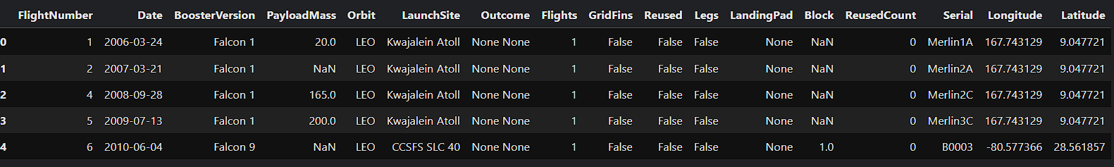
1) Data Collection
The API used is https://api.spacexdata.com/v4/rockets/, API includes data on SpaceX launches including Falcon 9 , therefore , we had to filter the available data to include only Falcon 9 ones.
The average value of feature was used to replace missing ones.
Notebook can be viewed here
Below is the sample of collected data:

Slide 8
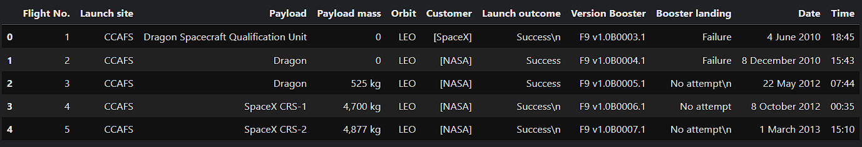
Data Collection - Scraping
Data collected through web scrapint of Wikipedia information.
121 recored were scraped and not book can be found on GitHub
Below first 5 rows of scrapped data.

Slide 9
Data Wrangling
Wrangling of data included identifying and replacement of missing value using the mean value of feature.
Also created new column ‘Class’ to indicate failure / success of landing. Successful landings were assigned (1) and failed ones were assigned (0)
At the end of data wrangling , our data ended with 90 rows (observation ) and 18 features.
Data wrangling notebook could be found in my GitHub URL.

Slide 10
EDA with Data Visualization
Pandas and NumPy used to perform EDA on launching data including :
The number of launches on each launch site
The number of occurrence of each orbit
The number and occurrence of each mission outcome
Matplotlib and Seaborn libraries were used to visualize data thorough scatterplots, bar charts and line charts. The following visual presentation was performed :
The relationship between flight number and launch site
The relationship between payload mass and launch site
The relationship between success rate and orbit type
The completed EDA with data visualization notebook was uploaded to GitHub URL.

Slide 11
EDA with SQL
SQL queries performed including :
Names of the unique launch sites in the space mission
Total payload mass carried by boosters launched by NASA (CRS)
Average payload mass carried by booster version F9 v1.1
Complete EDA with SQL was uploaded to GitHub URL

Slide 12
Build an Interactive Map with Folium
Interactive map was created using Folium library to visualize launching sites and to highlight successful landing , in addition Folium interactvie maps provided the following :
Location of all launching sites.
Identify failed and successful launches as spots on the map.
Provided proximity distance form nearest landmarks.
The notebook visualizing launch data on maps can be found on GitHub URL

Slide 13
Build a Dashboard with Plotly Dash
An interactive dashboard was generated using Dash library that provides interactive plots.
Completed notebook can be found on GitHub URL

Slide 14
Predictive Analysis (Classification)
Sklearn machine learning library used to build ML models.
The following steps applied on our dataset to determine the most effective predictive model :
Standardize data.
Splitting data to train / test groups using train_test_split function
Initiating the following ML models:
Logistic Regression (LR)
Support vector machine (SVM)
Decision Tree (DT)
K Nearest Neighbors (KNN)
Fitting model on training data.
Hypermeter tuning using GridSearch function of Sklearn.
Model evaluation using accuracy score measure and the confusion matrix.
Completed notebook can be found on GitHub URL

Slide 15
Results
Following slides demonstrate the results form :
Exploratory data analysis with SQL
Exploratory data analysis with visualization using Matplotlib and Seaborn.
Map visualization from Folium.
Predictive model analysis results

Slide 16

Section 1

Slide 17
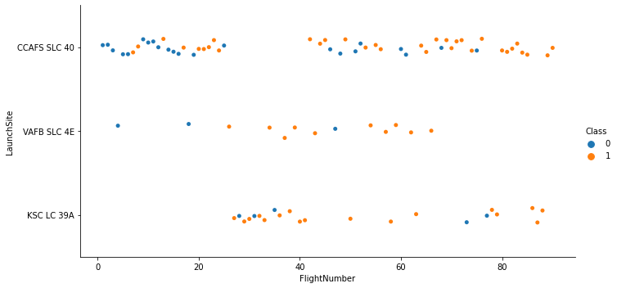
Flight Number vs. Launch Site
As shown below , higher success rate was accomplished with more launches for “CCAFS SLC 40” launch site.

Slide 18
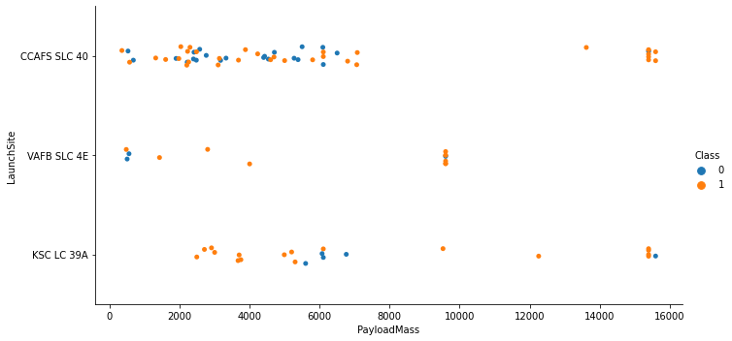
Payload vs. Launch Site
High success rat for launches from “CCAFS SLC 40” site was achieved for higher payload launches . While “KSC LC-39A” demonstrated high success rate for less heavy payloads.

Slide 19
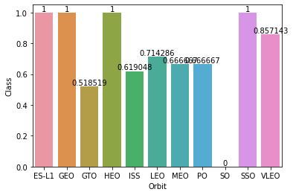
Success Rate vs. Orbit Type
Some relation exists between Orbit Type and success rate, which may be distorted due limited number of launches from certain orbits.

Slide 20
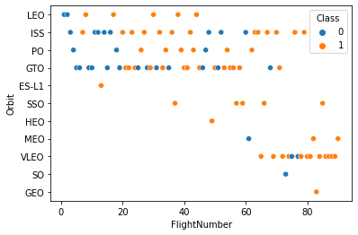
Flight Number vs. Orbit Type
It can be noticed that success rate enhanced with more flights from certain orbits such as “LEO”.

Slide 21
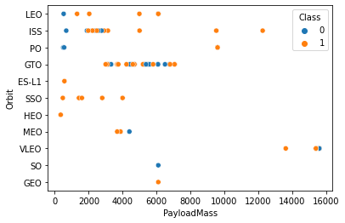
Payload vs. Orbit Type
With heavy payloads the successful landing or positive landing rate are more for Polar,LEO and ISS.

Slide 22
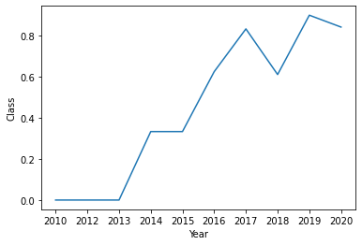
Launch Success Yearly Trend
Success rate improved with years as result of gained experience and improved technologies

Slide 23
All Launch Site Names
Unique launch sites are :
CCAFS LC-40
CCAFS SLC-40
KSC LC-39A
VAFB SLC-4E

Slide 24
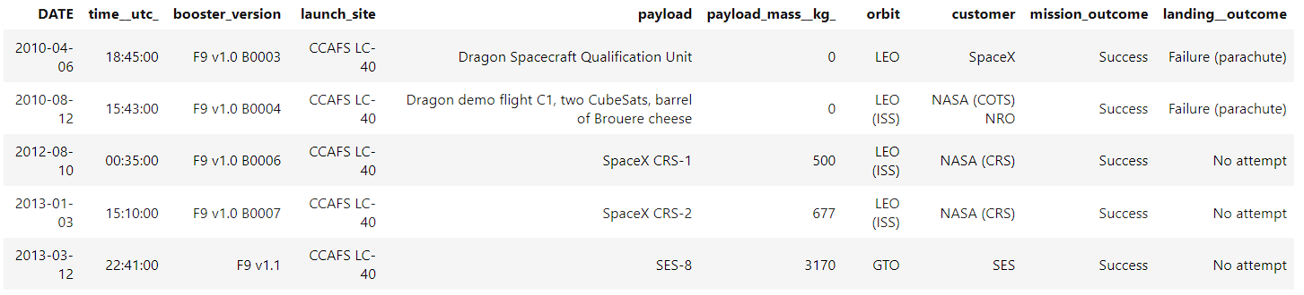
Launch Site Names Begin with 'CCA'
records where launch sites begin with `CCA` are :

Slide 25
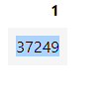
Total Payload Mass
Calculated total payload carried by boosters from NASA was 37249

Slide 26
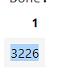
Average Payload Mass by F9 v1.1
Calculated average payload mass carried by booster version F9 v1.1 was 3226

Slide 27
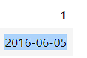
First Successful Ground Landing Date
The date of the first successful landing outcome on ground pad was 2016-06-05

Slide 28
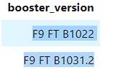
Successful Drone Ship Landing with Payload between 4000 and 6000
Names of boosters which have successfully landed on drone ship and had payload mass greater than 4000 but less than 6000 are :
F9 FT B1022
F9 FT B1031.2

Slide 29
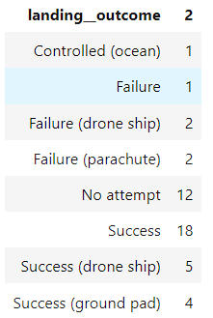
Total Number of Successful and Failure Mission Outcomes
Total number of successful and failure mission outcomes

Slide 30

Section 3

Slide 31

Folium Map
All launch sites

Slide 32
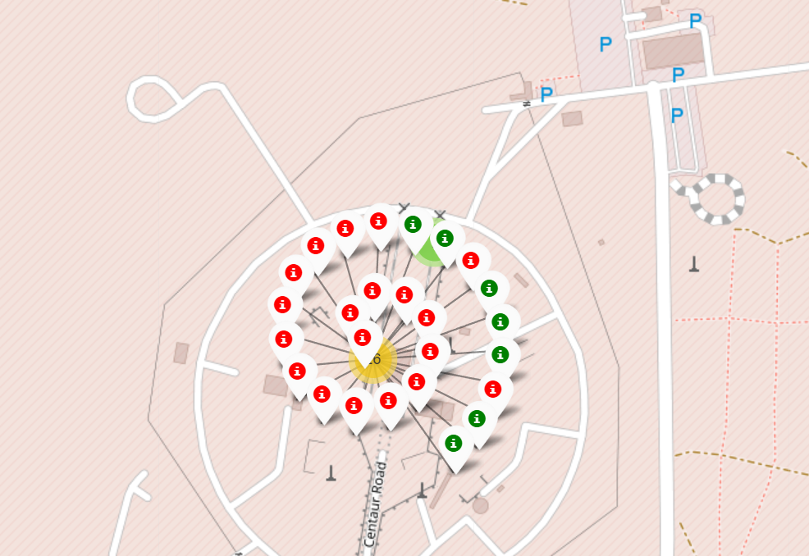
Launch outcomes on map

Slide 33

Section 5

Slide 34
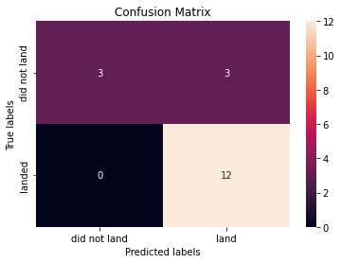
Classification Accuracy
Logistic Regression
Accuracy on test data : 0.833
GridSearchCV best score : 0.821
Confusion Matrix :

Slide 35
Classification Accuracy
Support Vector Machine Classifier
Accuracy on test data : 0.833
GridSearchCV best score : 0.848
Confusion Matrix :

Slide 36
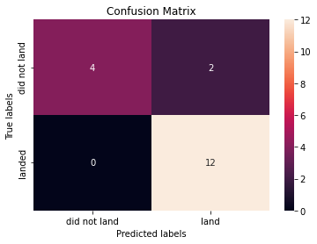
Classification Accuracy
Decision Tree Classifier
Accuracy on test data : 0.889
GridSearchCV best score : 0.889
Confusion Matrix :

Slide 37
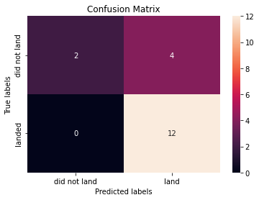
Classification Accuracy
K Nearest Neighbours Classification
Accuracy on test data : 0.778
GridSearchCV best score : 0.833
Confusion Matrix :

Slide 38
Confusion Matrix
Decision Tree model was the best model in terms of prediction accuracy , as shown form the confusion matrix , the 12 true positive predictions against 2 false negative predictions ( i.e. the model failed to predict 2 out of 14 successful landing.

Slide 39
Conclusions
We can conclude that higher landing success rate can be achieved from launches from KSC LC-39A and VAFB SLC 4E which is having a success rate of 77%.
Success rate is increasing with passage of time and number of launches, improvement in the success rate can be seen in recent years which is attributed to acquired experience from cosicutive launches.
Launching higher Payload Mass from CCAFS LC-40 achieved higher success rate , while KSC LC-39A site was more suitable to lower Payload Mass .
Decision Tree model has the highest accuracy rate in predicting success rate of at 88.9% accuracy level.

Slide 40


